Slide 1
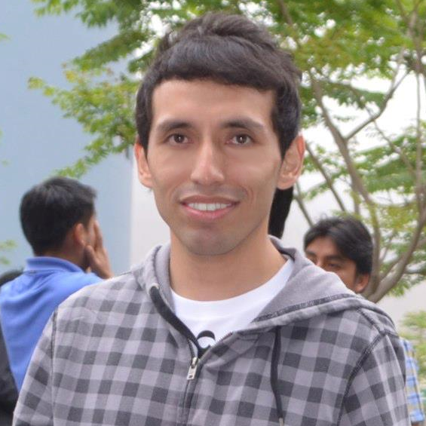





Angel núñez Agile Consultant & Trainer
Notes:
CSP | CSM | CSPO | CSD

Slide 2

Software Debt Qué es y cómo gestionarlo holísticamente

Slide 3
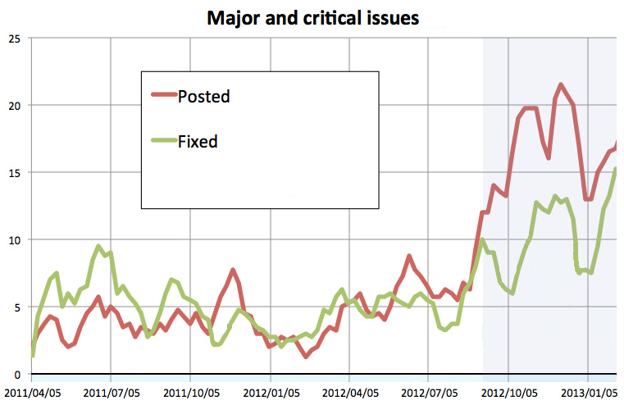
Un caso real
Notes:
http://xjm.drupalgardens.com/blog/technical-debt-drupal-8-or-when-will-it-be-ready
El Release Candidate será creado cuando no existan issues abiertos, basado en esta información ¿Cuándo sería esto?
A) 2013/02/05 B)En los siguientes 3 meses C) Nunca

Slide 4

La victima
Drupal Core
Versión: 8.0 Dev
Uno de los CMS más usados y populares del mundo.
Notes:
http://xjm.drupalgardens.com/blog/technical-debt-drupal-8-or-when-will-it-be-ready

Slide 5
drupal Release timeline
V2
V3
V4
V4.5
V5
V6
V7
V8
V1
¿?
Notes:
Drupal se ha caracterizado por ciclos pequeños de releases.
Qué es lo que está ocasionando que los bugs crescan, por lo tanto que existan etapas largas de pruebas que terminan impactando en las fechas de los releases y finalmente difucultanto que el producto responda a las necesidades de mercado
Entonces cual ese problema, ese asesino oculto a

Slide 6
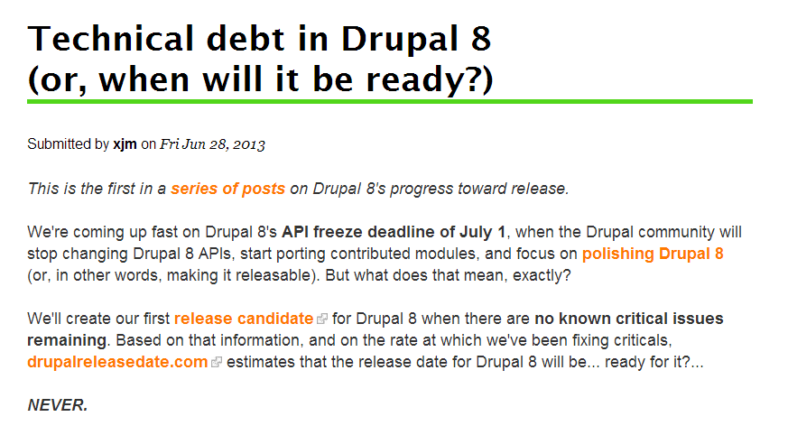
EL PROBLEMA
http://xjm.drupalgardens.com/blog/technical-debt-drupal-8-or-when-will-it-be-ready
Notes:
http://xjm.drupalgardens.com/blog/technical-debt-drupal-8-or-when-will-it-be-ready
http://cvlive.blogspot.com/2013/07/technical-debt-drupal-development.html
Aunque que todos salgan despavoridos queriendo cambiar sus blogs o páginas esta historia tiene un final feliz. Y el primer paso para llegar a este final feliz es que el equipo de Drupal ya ha encontrado el problema y es nada más y nada menos que la TD. Ese asesino silencioso que puede acabar poco a poco con productos y empresas.
Antes de contar en que acaba esta historia, expliquemos que es esto de deuda técnica.

Slide 7
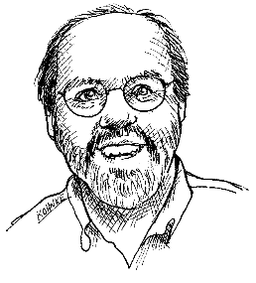

Metáfora
Shipping first-time code is like going into debt.
A little debt speeds development so long as it is paid back promptly with a rewrite.
The danger occurs when the debt is not repaid.
Every minute spent on not-quite-right code counts as interest on that debt.
Notes:
REF: TechnicalDebt: The Economics of Technical Debt
Every development manager has faced the choices: Ship sooner? Squeeze in an extra feature? Test a littleless to cut cost? Invest in infrastructure? Rewrite that problematic code? Virtually every development cycle goes through a similar set of tradeoffs multiple times in the course of getting code out the door. Every time a decision is made, the overall quality, maintainability, complexity, and stability of a software system goes up or down. While this problem has been well understood for years, it is only recently that the effects of these tradeoffs are starting to reach the consciousness of mainstream development managers. Even fewer of these managers have the vocabulary and processes to explain their decisions and tradeoffs to team mem-bers and stakeholders. Much as basic financial skills are necessary for consumers, every development man-ager needs a framework and tools for understanding, controlling, and communicating the costs and conse-quences of “technical debt” in their projects.
Ward Cunningham desarrolló una metáfora muy importante que nos ayuda a entender este problema, en la cuál se hace una analogía entre las decidiones técnicas y las deudas financieras.
METAFORA
Cada vez que nosotros decidimos hacer algo de manera rápida y sucia estmos incurriendo en una deuda, similar a una deuda financiera. Similar a como el negocio decide tomar una deuda para aprovechar una oportunidad financiera, el equipo de desarrollo puede incurrir en una deuda técnica para cumplir uan meta importante. De manera similar a la deuda financiera, la deuda técnica trae intereses, que aparecen como esfuerzo extra o problemas que tenemos que enfrentar en el futuro debido a este rápido y sucio diseño.
REF: TechnicalDebt: The Economics of Technical Debt
In other words, there are costs to addressing technical compromise. And if you do not address it, you will pay ongoing costs as future development becomes more and more difficult. Customers are exposed to this complex-ity in slower response times to their requests, harder-to-use software, and additional defects. By comparing this complexity to the real-world concept of debt, Cunningham gave us a way to help nontechnical folks easily conceptualize the effects of the issue and for project teams to more objectively weigh options.
------------------------------------------------
However, like financial debt, unrestrained borrowing can lead to a broad spectrum of difficulties, from collapsed roadmaps to inability to respond to customer problems in a timely manner, and anything in between.
“Technical!debt is everything that makes your code harder to change.”
(Tom!Poppendiek Lean!So[ware! Development)
Ref: Managing TD – ACM Queue – Pag 1
Technical debt often results from the tension between engineering “best practices” and other factors (ship date, cost of tools,and the skills of the engineers that are available, among others).Roughly speaking, technical debt is acquired when engineers take shortcuts that fall short of best practices
WHY SHOULD YOU CARE (WASTING MONEY, COST OF CHANGE, INTERESTS, TRIANGLE)

Slide 8
Cost of Change
Respuesta al Cliente
Costo del cambio (CoC)
CoC Actual
Deuda Técnica
CoC Óptimo
Tiempo
Notes:
REF: Technical Debt: The Economics of Technical Debt
Jim Highsmith captured the problem well. If you do not con-stantly strive to stamp out this unnecessary complexity, your software will become more and more unmaintain-able — to the point that you either have to bolt less complex software around it (i.e., software you canmain-tain), replace it, or abandon it altogether.
http://jimhighsmith.com/the-financial-implications-of-technical-debt/
shows how technical debt increases the cost of change over time, until software becomes almost un-maintainable. Two time scales can be shown on this curve, a longer term scale that shows how software degrades over time and severely impacts customer responsiveness, and a shorter term (by iteration) scale that shows how technical debt can seriously impact development speed very quickly.
http://theagileexecutive.com/2010/10/06/the-real-cost-of-one-trillion-dollars-in-it-debt-part-ii-the-performance-paradox/
As Jim astutely points out, “once on far right of curve all choices are hard.” My experience as well as those of various Cutter colleagues have shown it is actually very hard. The reason is simple: on the far right the software controls you more than you control it. The manifestations of technical debt [1] in the form of pressing customer problems in the production environment force you into a largely reactive mode of operation. This reactive mode of operation is prone to a high error injection rate – you introduce new bugs while you fix old ones. Consequently, progress is agonizingly slow and painful. It is often characterized by “never-ending” testing periods.

Slide 9
Definición
"Technical Debt is everything that makes your code harder to change"
Tom Poppendieck Lean Software Development

Slide 10
Mi definición
"Obligaciones que una organización toma cuando disminuye la calidad interna del producto para lograr metas a corto plazo pero que son perjudiciales a largo plazo"
Angel Núñez (@Snahider)

Slide 11
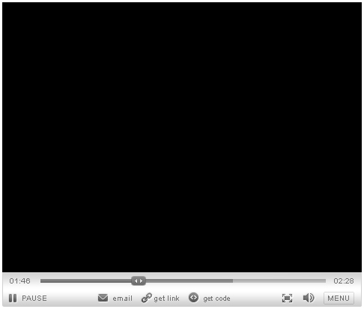
Ejemplo de TECHNICAL DEBT (Terriblemente familiar)
https://elearning.industriallogic.com/gh/submit?Action=PageAction&album=trw&path=recognizingSmells/technicalDebt/technicalDebtMismanagement&devLanguage=Cpp
Notes:
https://elearning.industriallogic.com/gh/submit?Action=PageAction&album=trw&path=recognizingSmells/technicalDebt/technicalDebtMismanagement&devLanguage=Cpp

Slide 12
TECHNICAL debt is bad
Tomar Deuda Técnica
Acumula la Deuda
"La deuda técnica es como una adicción a las drogas.
Un vez que empiezas a hackear el código, el código pide más."
(Más) Incesante Presión
Reduce Velocidad Equipo
CICLO VICIOSO
No pagar Duda Técnica
Notes:
Un problema muy común en las organizaciones es que la deuda es completamente olvidada y se sale de control.
EF: TechnicalDebt: The Economics of Technical Debt
all too common problem is that development organizations let their debt get out of control and spend most of their future development effort paying crippling interest payments.
La deuda técnica no es como una deuda con el banco. "Es una deuda con la mafia".
http://theagileexecutive.com/2010/04/19/toxic-code/
The dire consequences of the pressure to quickly deliver more functions and features to the market have been described in detail in various posts in this blog (see, for example, Toxic Code). Relentless pressure forces the development team to take technical debt. The very same pressure stands in the way of paying back the debt in a timely manner. The accrued technical debt reduces the velocity of the development team. Reduced development velocity leads to increased pressure to deliver, which leads to taking additional technical debt, which… It is a vicious cycle that is extremely difficult to break.
The problem with payday loan debt is that once you've taken it on, you usually can't have enough time to pay it back. That is because there is usually another deadline coming that you also won't be able to hit without taking additional debt. Remember, debt is never free; it will always reduce your overall availability to work. So if you can't complete your task in the allotted time without taking on debt, you won't be able to complete the next one either. So you accumulate more debt. And it continues as a vicious cycle.
http://launchingtechventures.blogspot.com/2011/03/creating-mountains-of-technical-debt-in.html
The issue of technical debt accumulation is further compounded by the fact that once technical debt has been accumulated, cost-benefit analysis will often show that paying off the debt creates value in the long term, but destroys value in the short term – thus a bad decision if you are choosing the most efficient lean path to the next milestone. This vicious cycle of technical debt accumulation can result in large amounts of increasing debt overhang, causing significant amounts of interest payments that significantly hinder and potentially stall further development. The vicious technical debt cycle is analogous to taking out increasingly higher rate credit cards to pay off previous debt accumulated; you keep buying yourself a short term lifeline at an increasingly higher long term penalty.

Slide 13
Consecuencias
Consecuencias
Incrementa el tiempo de entrega
Numero significativo de defectos
Disminuye la predictibilidad
Frustración
Disminuye la satisfacción del cliente
Bajo Rendimiento
Aumento en los costos de desarrollo y soporte
Notes:
However, like financial debt, unrestrained borrowing can lead to a broad spectrum of difficulties, from collapsed roadmaps to inability to respond to customer problems in a timely manner, and anything in between.

Slide 14
TECHNICAL debt is good
DECISIÓN estratégica prudente
Entrega rápida al mercado para obtener feedback.
Reducir costos iniciales, generar ingresos y autofinanciar el producto.
Fechas sensitivas de entrega.
Notes:
REF: SPaMCAST – Interview Israel Gat
Es bueno muchas veces como un decisión estratégica [ejemplos] esto es absolutamente legítimo y es parte de la metáfora, pero las presiones del día nos forza a tomar continuamente shortcuts, afectan la calidad del software y se acumulan exponencialmente.
Al menos que tomes acciones vas a encontrar que a lo largo de tiempo el software se degrada, no muy diferente de los carros que se están oxidando y cayendo por el paso del tiempo.
Un buen equipo que entiende completamente que sucede cuando toma una deuda, y paga esa deuda prontamente, puede utilizar desde un punto de vista estratégico. La mayoría de las veces sucede que las presiones del día a día no permite al equipo que pague la deuda y el interés se acumua de manera similar a la deuda financiera.
REF: Essencial Scrum – Cap. Technical Debt
This kind of debt is a tool that can be used to help organizations better quantify and leverage the economics of important, often time-sensitive, decisions. For example, an organization might deliber-ately make a strategic decision to take shortcuts during product development to achieve an important short-term goal, such as getting a time-sensitive product into the market-place. Also, for a capital-strapped organization that is at risk of running out of money before it can complete its product, getting a product with technical debt to market at a reduced initial development cost and then generating revenue to self-fund ongoing development may be the only way for the organization to avoid death before deployment.
http://blog.activelylazy.co.uk/2010/10/21/the-true-cost-of-technical-debt/
There are obviously cases where it makes sense to add technical debt; or at least, to do something half-assed. If you want to get a new feature in front of customers to judge whether its valuable, it doesn’t need to be perfect, it just needs to be out there quickly. If the feature isn’t useful for users, you remove it. You’ve saved the cost of building it “perfectly” and quickly gained the knowledge you needed. This is clearly a cost-effective, lean way to manage development.
But what if the feature is successful? Then you need a plan for cleaning it up; for refactoring it; making sure it’s well tested and documented sufficiently. This is the debt. As long as you have a plan for removing it, whether the feature is useful or not – then it’s a perfectly valid approach. What isn’t an option is leaving the half-assed feature in the code base for years to come.
The difference is having a plan to remove the debt. How often do we accept compromise with a vague promise to “come back and fix later” or my personal favourite “we’ll fix that in phase 2″. My epitaph should be “now working on phase 2″.
Leaving debt in the code with no plan to remove it is like the guy who pays the interest on one credit card with another. You’re letting the debt mount up, not dealing with it. Without a plan to repay the debt, you will eventually go bankrupt.
http://verraes.net/2013/07/managed-technical-debt/
Businesses take loans all the time. They are a powerful tool to make an investment now, and pay for it later. It’s a fundamental aspect of our economy.

Slide 15
CLEAN CODE Y DISCIPLINA SON OBLIGATORIOS
El código es limpio?
He estimado el costo beneficio?
Hay un plan para pagar la deuda?
No he introducido más deuda sobre deuda existente.
Notes:
http://verraes.net/2013/07/managed-technical-debt/
Managed
The team is disciplined: it applies techniques such as refactoring, pair programming, iterative development, CI, TDD (or other testing schemes) …
The codebase is well structured, well tested, and stable.
When introducing new technical debt, the team estimates the cost/benefit.
Even though the introduced solution is not optimal, the team understands what the optimal solution would be, and how the current solution can later be evolved towards that goal.
Technical debt is documented.
Technical debt is not introduced on top of existing technical debt.
Existing technical debt is paid off as soon as there’s a clear need.
http://compsoftplc.blogspot.com/
This isn't an excuse to write code poorly now: if it's debt, you intend to pay it back. You can only do this if you write the code in a way that you can refactor it into a better shape later on. Dirty code is to technical debt as the pawn broker is to financial debt.
If you don't have a plan to get out of the debt you're in, you don't have technical debt, you just have a mess; cruft.

Slide 16

Enfrenta la cruda realidad
La Deuda de Software es inevitable
Notes:
http://martinfowler.com/bliki/TechnicalDebtQuadrant.html
http://zacgery.blogspot.com/2013/05/technical-debt-in-agile-world.html
Although technical debt can be reduced with good practices, it is unavoidable.
REF: Essential Scrum – Pag 140
In addition, there is unavoidable technical debt, which is usually unpredictable and unpreventable. For example, our understanding of what makes for a good design emerges from doing the design work and building user-valuable features on it. We can’t perfectly predict up front how our product and its design will need to evolve over time. So, design and implementation decisions we made early on might need to change as we close important learning loops and acquire validated

Slide 17
El problema no es eliminar la deuda sino gestionarla
Notes:
Ref: Managing TD – ACM Queue – Pag 4
Technical debt is inevitable. The issue is not eliminating debt, but rather managing it. When
a project starts, the team almost never has a total grasp on the totality of the problem.

Slide 18

No caigas en la trampa
El responsable no sólo es el desarrollador
El problema no sólo es el código
La solución
no sólo es refactoring
Notes:
NO SOLO EL EQUIPO DE DESARROLLO
http://www.infoq.com/articles/managing-technical-debt
If developers identify Technical Debt, communicate it, and nothing happens, sooner or later business people will feel these problems too. This statement clearly shows: Technical Debt is not a gimmick of developers who want beautiful code. It is a tangible cost factor and may be a risk for a project. Therefore Technical Debt must be made visible and manageable. As in real life, debt is not necessarily a bad thing, but it must be used consciously and properly. This means for software projects that paying back Technical Debt is a pure business decision. It must not simply a developer's decision.
TODO: Puede Ser frase para “Involucrar y Educar” o “Visible or Measure” o “No solo desarrollo”
http://agileconsortium.blogspot.com/2011/07/scrum-hates-technical-debt.html
And I agree that Technical Debt is ultimately a business problem. The business people must ultimately decide when and how much to fix. But, they need the geeks to explain the details of the problem to them (typically they don't understand at all or very little).
NO SOLO EL CODIGO
hey can cover your data model, your user interface, your build process, your test automation processes, and even “anchors” related to source code management.

Slide 19

Software debt
Quality Debt
Technical Debt
Design Debt
Configuration Management Debt
Infrastructure Debt
Notes:
Se acuño el término software debt no con el objetivo de dar una categorización exacta sino resaltar que la deuda va más ayá de únicamente el código y ….
http://www.informit.com/articles/article.aspx?p=1684785
My reason for making these other types of software debt explicit is that it allows teams to be more focused in their efforts to identify and clean it up. Also, I have found that these types of software debt all have different ways to monitor and manage them from tools, process, and people perspectives.
TAXONOMIA
Technical debt Problemas en el código que afectarán el futuro desarrollo y reducen la capacidad del software de satisfacer las necesidades del negocio.
Quality debt Disminuir la habilidad de verificar funcional y técnicamente la calidad de todo el sistema
Configuration management debt Limitaciones que ocasionan que la liberación y despliegue del sea manual, lleve mucho tiempo y sea propensa a errores.
Infrastructure Debt These lessons are broadly relevant and can be applied to create efficient, effective, expedient, and flexible computational infrastructures and processes.
DEJAR EN CLARO QUE ES ACERCA DE HACER EL SISTEMA CORRECTAMENTE, NO EL SISTEMA CORRECTA
REF: Technical Debt (CutterIT) – Pag 3
Technical debt is about doing the system right, not about doing the right system. It is essentially a quantifiable measure of how good the quality of your code is.
It does not address functional completeness, nor can it predict success in the market.

Slide 20


Gestión holística
Involucrar y Educar
Business
Gestionar el Portafolio
Visualizar y Medir
Dev Team
Atender y Pagar
Sostener la Calidad

Slide 21

Involucrar y EDUCAR
Notes:
Broma de no ponernos a refactorizar un sprint entero, tenemos que entregar valor.
El negocio el debe ser responsible de planificar priorizar, tomar deudas y afecta claramente al negocio.
Technical Debt is, and should be, a PM's concern
http://www.codovation.com/2012/06/effective-steps-to-reduce-technical-debt-an-agile-approach/
Product Owner often doesn’t understand the need and benefits of reducing technical debt and don’t consider or allow technical projects / stories in their backlog and release plan.
(Pensar donde va)
http://pm.stackexchange.com/questions/7954/how-do-you-manage-technical-debt
Educate the business about the cost of technical debt
Technical debt only happens in the face of time pressure (or as a result of bad habit or lack of skill, which are a different problem, solved by having time to learn how to do the job well... so, time pressure).
By keeping track of the growing cost of the debt and making the business aware of it, you can help to show them the value of the options they're losing. This could include things like your best developers leaving, and the cost of re-hiring; how much extra time the devs reckon it took to create a new feature as a result of technical debt; how much more effective the team is when they're given the chance to take pride in their work instead of bowing to business pressure.
Also educate them about the alignment trap. "Companies in which IT was highly aligned with business but not effective were considerably worse off than companies in which IT was less aligned and merely kept the systems running.“
http://www.infoq.com/articles/managing-technical-debt
Stakeholders of Technical Debt
Technical Debt concerns many stakeholders of a software project:
Customers are annoyed by bugs or missing features due to low productivity.
This leads to additional costs for the helpdesk, which annoys the people there, too.
Increased development time and quality issues are also a problem for marketing.
Bugs lead to frequent patches, which annoys the operations team.
Many annoyed parties definitely don’t make the management happy - especially if there is bad publicity due to bugs, delays or security problems.
Last but not least also the developers are suffering. No one wants to deliver bad work. Furthermore, no one wants to take over the bad work of others.

Slide 22

Involucrar al product owner
Patrocinador de la reducción de la deuda de software
Notes:
http://blog.crisp.se/2013/07/12/henrikkniberg/the-solution-to-technical-debt (QUOTES)
Quality is invisible in the short term, and that needs to be explained.
Sometimes it’s worth it, sometimes not. The answer is not obvious, it’s a business decision, so make sure you involve the people who are paying for it.
http://www.codovation.com/2012/06/effective-steps-to-reduce-technical-debt-an-agile-approach/
Product Owner often doesn’t understand the need and benefits of reducing technical debt and don’t consider or allow technical projects / stories in their backlog and release plan
http://www.codovation.com/2012/06/effective-steps-to-reduce-technical-debt-an-agile-approach/
The first important step in such a process is often to raise the technical awareness of the person who is responsible for the product. This guy should be the person who is talking about technical sustainability and quality on the front lines. Teams are lucky when already working with a product owner or manager who understands the life cycle of software systems – how software evolves – and thereby the impact of technical debt. In this situation it’s all about bringing the topics and to-do’s on the table and helping to prioritize them. For teams without this kind of a product owner this could really be a show stopper. Discussing the responsibility for the overall product including the quality and stability of underlying software systems like a mantra does not help much. The team should remember the product owner that he is part of the team: his pain is the pain of the team and other way round. He is not the customer, payer or employer of the team but more a SME (subject matter expert) and manager / analyst of product requirements from different stakeholders.
As a team give your product owner the guarantee that growth of the product will stay the most important part – but not just in a short team (Performance) but also in a long term (Health) manner. Depending on how active the product owner is integrated into the development process it can be helpful to present different options of how to reduce technical debt to him and involve him in discussion to find the best approaches.
For most product owners this situation will be quite common since they do the same all the time with their stakeholders: promote and inspire, explain and legitimate about agile, strengthen the WE… This shared challenge could be something like the carrier energy also for the establishment of technical debt reduction.

Slide 23
Usar la metáfora como herramienta de comunicación
"El concepto (Software Debt) es 1/3 útil para tomar de decisiones y 2/3 herramienta de comunicación"
Steve McConnell
Notes:
http://www.psclistens.com/white-papers/cio-tools-technical-debt.aspx
the concept of Technical Debt translates a complex technical cause-effect problem into ordinary business terms that our end-customers can readily understand.
Improved Project Communication
Technical Debt is an exceptionally powerful concept that provides a framework for building more equitable relationships between the business and technical project teams. When applied as a communication framework, Technical Debt opthrough the use of up-front contracts.
Better Relationships
In the end, the Technical Debt framework creates a good business discussion in terminology that is appealing to executives. Everyone understands that debt can not be ignored indefinitely.
Another great benefit of this communication framework is that it helps us avoid having to sell or justify the zero value-add technical projects (re-factoring, re-architecting, etc.) we have all had to do at one time or another.
http://www.sqale.org/blog/why-managers-like-the-technical-debt-concept
This is a very simple concept. It is easy to understand and facilitates communication.
http://www.ontechnicaldebt.com/blog/steve-mcconnell-on-categorizing-managing-technical-debt/
I have been working with this concept for the last 20 years now. But it has been a lot more active over the past 5 years. Today as I understand it, the concept is 1/3 helpful for technical decision making and 2/3 helpful as a communication tool between technical staff and business staff. I would encourage people to try it, we have had good results

Slide 24

Evaluar decisiones económicamente
Para utilizar la deuda de software de manera estratégica y beneficiosa, debemos entender como nuestras decisiones afectan económicamente.
Notes:
TODO: Cambiar Título (Evaluar Desiciónes Monetariamente)
REF: Essential Scrum – Pag 150
To use technical debt strategically and advantageously, we must properly understand how it affects the economics of our decisions. Sadly, most organizations don’t under-stand the implications of technical debt well enough to correctly quantify the economics of taking it on.
REF: Essential Scrum – Pag 152
Most organizations substantially underestimate the true cost of assuming technical debt and aren’t nearly as diligent as they think they will be at repaying it.
Lo subestiman hasta que sea muy tarde.
REF: Essential Scrum – Pag 154
each organization needs to find a way to communicate the magnitude of a product’s technical debt in a way that the business people can understand. Otherwise, the business doesn’t have the proper vis-ibility into the true condition of the product to make informed economic decisions.

Slide 25
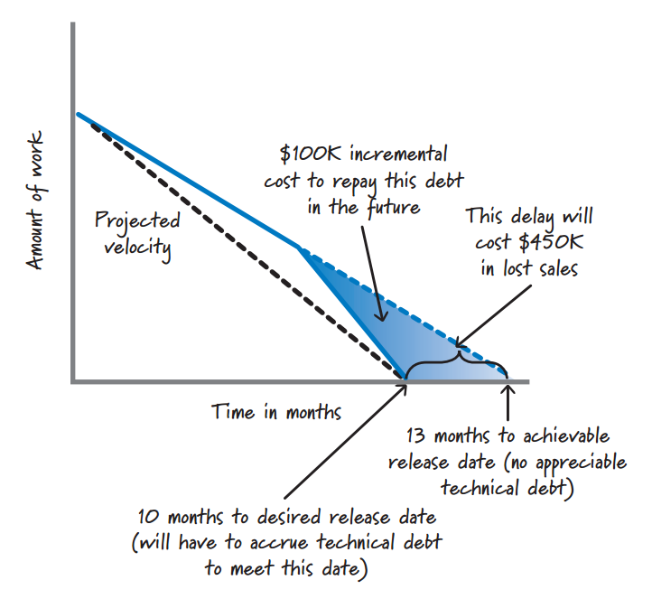
EJEMPLO
Alternativa 2 ( Sin Deuda)
Alternativa 1 ( Tomando Deuda)
Notes:
Doble click de TD buena
REF: Essential Scrum – Pag 150 -152
Let’s consider two possible alternatives. First, delay the delivery date of the prod-uct by three months so that we can reasonably and professionally complete the work on the must-have feature set with minimum technical debt at 13 months. The total development cost would then be $1.3M. In discussions with sales and marketing, we also project that a three-month cost of delay equates to $450K in lost sales. Second, accelerate development by taking shortcuts in order to meet the original target delivery date at ten months. To correctly quantify the economics of this option, we need to know the cost of taking on the technical debt.
This is where things get difficult. Imagine that we ask the development team, “So, if you have to make some design and implementation compromises today to get the must-have features done by the original desired date, how much additional money will it take to repay the debt after we do the first release?”
Let’s say the team discusses the question and believes it will need four months to get the system cleaned up. This means the team will need one additional month over and above the three months it “saved” by originally cutting corners. The net result is that the team will spend an incremental $100K on development ($1.4M on develop-ment instead of the $1.3M in the first option). That’s $100K the organization would not have to spend if we took the time to do the work the right way and did not put the technical debt into the product in the first place.

Slide 26
EJEMPLO
 | Tomando Deuda (Opción 1) | Evitando Deuda (Opción 2)
Costo Mensual de Desarrollo | $100k | $100k
Meses Desarrollo | 10 | 13
Total Costo Desarrollo | $1M | $1.3M
Perdidas en Ventas |  | $450k
Atender Deuda - Meses | 4
Atender Deuda Costo | $400
Costo Total | $1.4M | $1.75M
Otros costos de atender la deuda | X+Y+Z
Costo Total Real | $1.4M +x +y +z | $1.75M
¿Qué alternativa elegirían?
Notes:
REF: Essential Scrum – Pag 150 -152
On the surface, the correct economic decision seems clear. Should we take on a technical debt of $100K to generate incremental revenue of $450K? Sure, who wouldn’t do that? And that might be the correct answer if we believe that we have considered all (or even most) of the important cost factors associated with the techni-cal debt.
[Table]
Clearly, technical debt has tentacles that reach out and affect many different aspects of the overall economic calculation. Failing to consider at least the most important of these factors will ensure that we won’t correctly quantify the economics
of assuming technical debt.
Of course, if the economics in favor of taking on the debt are overwhelming and compelling—for example, we will go out of business if we don’t take on that debt and get the product into the marketplace with all of the must-have features, or we will
miss being first to market and lose the lion’s share of the marketplace revenue—we don’t need to spend time considering less important factors because we already know it’s economically sensible to take on the debt.
More often, however, the decision isn’t so clear-cut. The choice of whether or not to assume the debt usually requires detailed analysis to discern which is the better option. When deciding, err on the side of not taking on the debt. In my experience, most organizations substantially underestimate the true cost of assuming technical debt and aren’t nearly as diligent as they think they will be at repaying it.

Slide 27


Visualizar y Medir
Notes:
Si bien las métricas dan una visibilidad hay otras técnicas que nos

Slide 28
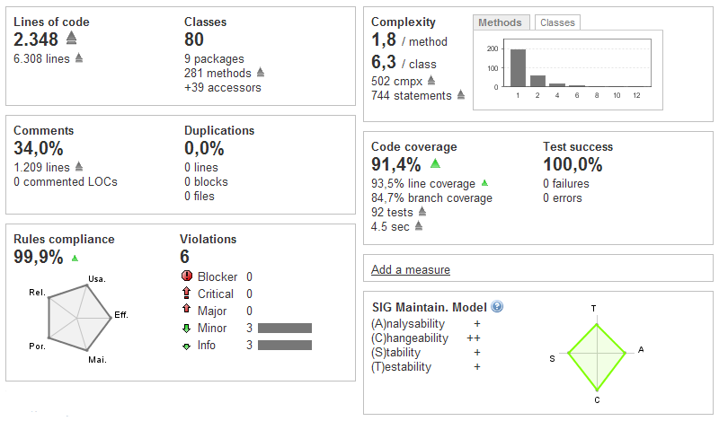
Métricas de código
Notes:
TODO: Que voy a hablar?
http://www.infoq.com/articles/managing-technical-debt
Automatically measuring Technical Debt is partially possible. Correctly configured, tools like Sonar, SonarJ or Structure101 find important violations of best coding practices.
These problems point to key challenges in the architecture. (Design and Code)

Slide 29
Velocity & Bugs
Notes:
TECHNICAL DEBT CANNOT BE MEASURE DIRECTLY IN CODE
http://www.infoq.com/articles/managing-technical-debt
But there are also a lot of cases in which systems have Technical Debt, but it cannot be measured directly in the code, e.g. clumsy solutions, wrong choice of technology, a well-executed, but wrong design for a solution or simply evil hacks that cannot be detected easily by tools. In these cases Technical Debt must be measured differently: the bugs per release rise rapidly, the velocity decreases permanently or the team is under extreme stress at the end of a release.
WHAT IS VELOCITY
http://braintrustgroup.com/2012/how-technical-debt-affects-your-velocity/
Velocity is a measure of how fast a Scrum team delivers business value.
I like to think of technical debt as a weight that has to be dragged around by the team. Until the weight is cut free, the overall efficiency of the team is going to be affected. Dealing with technical debt issues may cause your team to overestimate their backlog items. Thus, fewer backlog items can be completed during a Sprint because the estimates begin to add up quickly.
Not surprisingly, there is also an reverse relationship between velocity and technical debt.

Slide 30
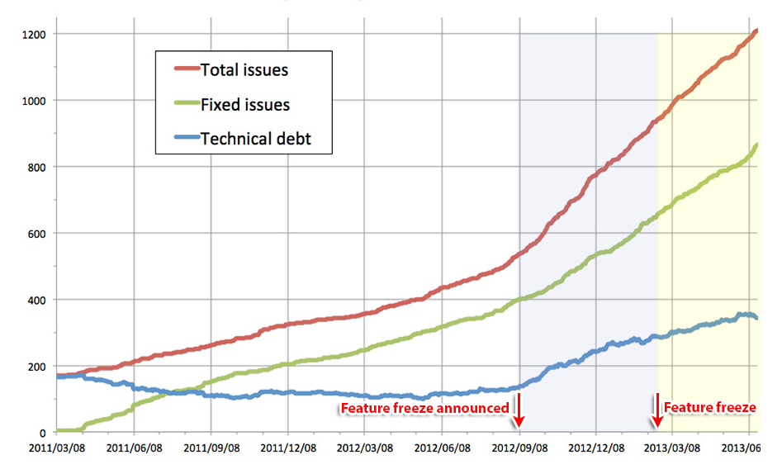
Cómo drupal mide
la deuda técnica

Slide 31
backlogs
Software Debt en el Product Backlog
Software Debt Backlog
Feature C
Defect 23
Refactor X
Feature B
Feature A
Software Debt
Notes:
REF: Essential Scrum
Technical people often have tacit knowledge of where at least the most egregious technical debt is located in the product. However, that understanding may not be visible in a way that it can be analyzed, discussed, and acted upon. Two ways of making technical debt visible at the technical level.
REF: Essential Scrum (Software Debt Items in Product Backlog)
Doing so will give important technical debt visibility on a par with that of new features in the product back-log. Teams typically use this approach when the cost of servicing the technical debt is quite high and the product owner needs to be involved in deciding how that work should be ordered relative to value-added new features in the product backlog.
REF: Essential Scrum (Software Debt Backlog)
Create a special technical debt backlog that makes individual technical debt items visible. Whenever new technical debt is discovered or introduced into the product, a development team member can create a new technical debt item and add it to the technical debt backlog. By making the technical debt items visible, the development team can not only see its technical debt position but also can proactively determine when it wants to service each piece of technical debt.
http://agile.dzone.com/articles/treat-technical-stories-user
Ron proposes that rather than using technical stories to improve testing practices or the existing software design, “testing and design improvement are inherently part of the work of doing stories” and therefore the proper solution is to “make the code a bit better every time we pass through it“. I agree 100% with this – from experience, the only effective way to improve codebase quality is a bit at a time, and to fix Broken Windows
what is a technical story?
A technical story is an item of work in the Software Debt Backlog that pays off a chunk of debt that is understandable and valuable to the Product Owner
The above definition means that the vast majority of problematic technical stories should be correctly classified as technical tasks – work to fix Broken Windows that can and should be accomplished within the context of a user story, as mandated by Ron. A technical story should only be applicable in the exceptional circumstance of a well-defined set of technical tasks being identified that will pay off a noticeable piece of Software Debt, in turn providing some business value.
http://www.infoq.com/news/2013/03/user-stories-technical-debt
http://www.jrothman.com/blog/mpd/2009/10/expressing-technical-debt-as-user-stories-helps-with-roi.html

Slide 32
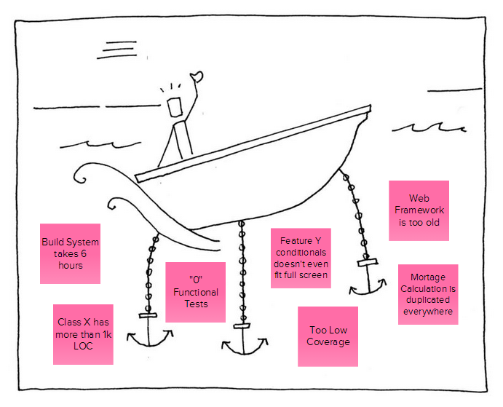
SPEED Boat
Software Debt que detiene al equipo
Tu Sistema
Notes:
http://www.gogamestorm.com/wp-content/uploads/2011/03/speedboat.jpg
http://innovationgames.com/2010/04/using-innovation-games%C2%AE-to-identify-and-prioritize-technical-debt/
Speed Boat Collaboratize process to identify the “anchors” that are holding the team back; In the case of the Speed Boat game, the “boat” is a metaphor for the system under development. I’ve previously discussed using Speed Boat for process improvement in thispost. In this case, you’re adapting the game so that the anchors are technical debt anchors. Note that these anchors are not just “code” anchors. They can cover your data model, your user interface, your build process, your test automation processes, and even “anchors” related to source code management.
http://innovationgames.com/2010/01/using-speed-boat-for-process-improvement/
Traditional approaches to process improvement typically start with some picture or description of the existing process and use this as the foundation of discussion for process improvements. While this can be effective as a way of considering process improvement, it has a very severe flaw: it forces the team to frame their issues and their perceptions of their problems to the process.That’s a real problem, as processes do not stand alone: they are supported by a larger structural context, which includes everything from the physical environment to the appropriateness of the results produced by the process. More importantly, I used the plural quite intentionally in the last sentence: there are always multiple processes that exist in a company, and these processes can interact in surprising ways. Prematurely framing the issues in terms of a single process inhibits the team from exploring critical interactions with other processes.
Metafora
This boat represents your development process. We know you want that boat to go as fast as possible. However, there are some anchors that are holding you back. On the anchor cards you’ve been given, write down one anchor per card. The anchor that you write down can be anything that you think is holding you back.”

Slide 33

SOSTENER EL RITMO Y LA CALIDAD
Notes:
Relación ritmo y calidad, ambos contribuyen a lograr lo otro.

Slide 34
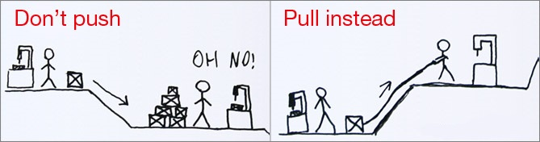
Pull systems
Permite alcanzar un ritmo sostenible de trabajo y que el equipo tenga poder y responsabilidad sobre la calidad.
Notes:
2 Beneficios: Reducir preción pero más importante dar responsabilidad al equipo
http://agiletrail.com/2012/04/30/people-signing-up-for-work/
Scrum and Kanban are both pull scheduling systems…. This means that the team chooses when and how much work to commit to, they “pull” work when they are ready, rather than having it “pushed” in from the outside. Just like a printer pulls in the next page only when it is ready to print on it (although there is a small & limited batch of paper that it can pull from).”
http://blog.crisp.se/2013/07/12/henrikkniberg/the-solution-to-technical-debt
YIf you Keep Writing Crappy Code, you get slower and slower over time (as you spend more and more of your time wrestling the code). If you Stop Writing Crappy Code, you get a more sustainable pace. But there is velocity cost – you will slow down in the short term.
As team, you decide how much work to pull in – that pull-scheduling principle is fundamental to both Agile and Lean. It’s built into the agile methods. For example, in Scrum Sprint Planning the team chooses how many backlog items to pull into a sprint, same in XP Planning Game. In Kanban, the team has a work-in-progress limit and only pulls in the next item when the current one is Done. Basically, the team has full power and responsibility over quality. Use the power!
Ejemplo Concreto
In concrete terms: If you are doing Scrum, and you’ve been delivering about 8-10 features per sprint, try reducing that. Only pull in 6 stories next sprint, despite any perceived pressure. Ask yourself at each sprint retrospective. “What is the quality of the code that we produced this sprint (scale 1-5)”. If it is less than 4-5, then pull in fewer stories next sprint. Keep doing that until you find your sustainable pace.
This has business implications of course. The product owner (or whatever you call the person who makes business priorities) will have to prioritize harder. She’s used to seeing 8-10 stories come out of each sprint. Now she will only see 6-7, so she needs to decide which stories NOT to build.

Slide 35
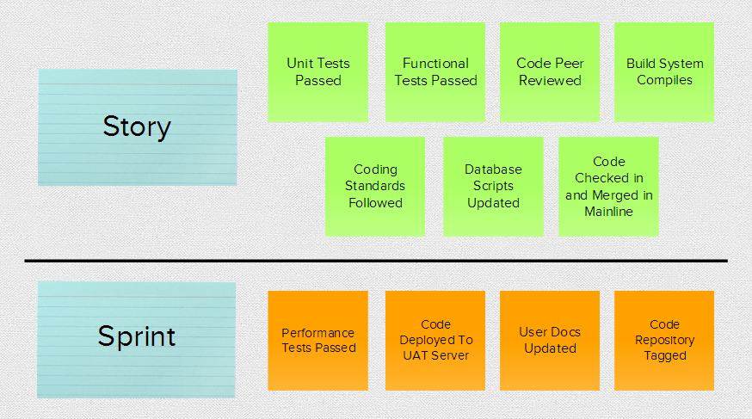
Definition of Done
Notes:
http://www.rallydev.com/sites/default/files/defining_done_guide.pdf
What Is It?
Agile teams make an agreement on what constitutes potentially shippable software in their environment. This agreement is called the definition of done.
The DoD serves as a contract the delivery team writes with its stakeholders as well as the team’s standard of excellence.
http://www.dzone.com/articles/definitions-done-practice
You can think of a Definition of Done as the key defensive bulwark in software development epidemiology. If you balance the right level of team oversight with the right level of trust, severe outbreaks of technical debt or rework will become rare.
permit the delivery of each User Story to a known level of quality.
anything less than "fully release ready" incurs the risk of technical debt and the need to pay it back later. (permite ver cuando riesgo de deuda estamos acumulando)
http://www.rallydev.com/sites/default/files/defining_done_guide.pdf
Remember that each layer beyond “delivered with the story” equates to accumulation of risk and debt

Slide 36
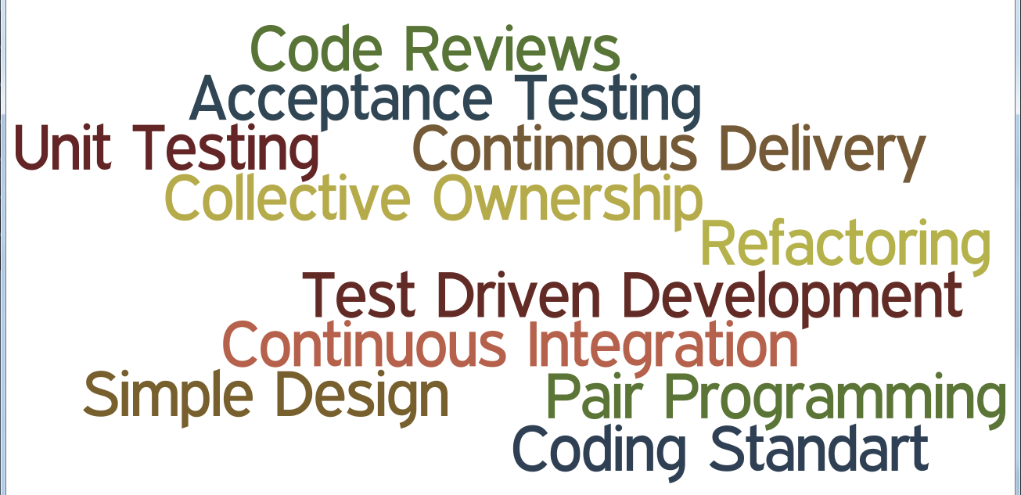
Prácticas Técnicas
Notes:
Pair~Programming Code~Reviews Continuous~Integration Unit~Testing Test~Driven~Development Refactoring Collective~Ownership Acceptance~Testing Continnous~Delivery Simple~Design Coding~Standart
Ref: Essential Scrum – Pag 140
Naive Debt
Cunningham didn’t intend for technical debt to refer to team member or businessimmaturity or process deficiencies that lead to sloppy design, poor engineering
practices, and a lack of testing. This kind of debt can be eliminated through proper training, a good understanding of how to apply technical practices, and sound business decision making. Because of the irresponsible and frequently accidental nature of how this type of debt is generated, I refer to it as naive technical debt. It is also known by other names: reckless debt (Fowler 2009), unintentional debt (McConnel 2007), and mess (Martin 2008).
Ref: Essential Scrum – Pag 149
Technical Practices
The first approach to managing the accrual of technical debt is to stop adding naïve debt to our products. Using good technical practices is an excellent starting point. Although Scrum does not formally define technical practices, every successful Scrum team that I have seen employs practices such as simple design, test-driven development, continuous integration, automated testing, refactoring, and so on (see Chapter 20 for additional discussion). Understanding and proactively using these practices will help teams stop adding many forms of naive debt to their products.
In the case of accrued technical debt, code refactoring is an important tool for paying it down. Refactoring is a disciplined technique for restructuring an existing body of code, altering its internal structure without changing its external behavior (Fowler et al. 1999). In other words, we clean up under the hood, but from the customer’s perspective the product still works the same. By refactoring, we strive to reduce complexity while improving maintainability and extensibility. The result of refactoring is making the work at hand easier (the equivalent of reducing interest payments).

Slide 37

Atender y Pagar la deuda

Slide 38
Enfoques para pagar la deuda
No Hacer Nada (No todas las deudas tienen que ser pagadas)
Aplicar “Boy Scout Rule” (Atender la deuda cuando te topes con ella)
Enfoques
Pagar la deuda mientras se realiza trabajo valioso para el cliente
Pagar la deuda incrementalmente
Notes:
REF: Essential Scrum – Pag 155
Not All Technical Debt Should Be Repaid
Sometimes technical debt should not be repaid. This is one area where the analogy with financial debt gets stretched. Typically the expectation is that all financial debt eventually will be repaid—although we know that isn’t always true!
There are a number of scenarios under which technical debt should not be repaid. I will discuss three: product nearing end of life, throwaway prototype, and product built for a short life.
Apply the Boy Scout Rule (Service Debt When You Happen Upon It)
There is a Boy Scout rule: “Always leave the campground cleaner than you found it.” If you find a mess on the ground, you clean it up regardless of who might have made the mess. You intentionally improve the environment for the next group of campers. Bob Martin (and others) has nicely explained why this rule applies to product development and technical debt (Martin 2008).
Following this rule, we try to always make our product design and implementation a little better, not a little worse, every time we touch it. When a development
team member is working in an area of the product and sees a problem (happenedupon technical debt), she cleans up the problem. She doesn’t do this just because it is good for her, though it almost certainly is, but also because it is good for the whole development team and the organization.
The algorithm provided earlier stated that we service the happened-upon debt up to a reasonable threshold. We can’t just blatantly say that the team should service the entire happened-upon technical debt when it is discovered. The servicing of that debt might require significant effort, and the team is in the middle of a sprint in which it has other work to complete. If the team tries to service the entire debt, it may not be able to meet its original sprint goal.
To address this issue, the team might budget a percentage of time to allow for servicing happened-upon debt when it is discovered. One way to set this budget is to increase the estimated size of individual PBIs to allow for the additional debt servicing that typically occurs. Alternatively, the team might choose to budget a percentage of its capacity during sprint planning to service happened-upon debt. Examples I have seen in the past range from 5% up to 33% of the sprint capacity. You should let your particular circumstances guide your capacity allocation if you choose to use this approach.
As for any happened-upon debt that is not serviced when discovered, it should be classified as known debt and made visible using whatever technique the team has decided to use for visualizing technical debt.
Trabajar la Deuda mientras se realiza trabajo valioso en el cliente
Let’s assume that for every customer-valuable product backlog item we work on, we also do several things. First, we commit to doing high-quality work so that we don’t add new naive technical debt when we create the customer feature. Second, we apply the Boy Scout rule and clean up whatever happened-upon technical debt that we reasonably can when we are in the area doing work related to our feature. And third (the core attribute of this approach), we specifically repay targeted technical debt in the area in which we will be working.
Using this approach has several advantages:
It aligns debt reduction work with customer-valuable work that the product owner can properly prioritize.
It makes it clear to all development team members that technical debt reduction is a shared responsibility and not something to defer and delegate to someone or some other team to clean up.
It reinforces technical debt prevention and removal skills because everyone gets to practice them all the time.
It helps us identify the high-interest areas where we should focus our technical debt servicing. At the very least we know that the code (or other development artifact) we are touching is still important because we are using it to create the new feature.
It avoids the waste of repaying technical debt in areas where we really don’t have to.
Using this approach, known technical debt items are entered into a technical debt backlog that is placed on the wall next to the sprint backlog during sprint planning (or inside a tool to achieve the equivalent effect).
During sprint planning, as the team members are working with the product owner to select customer-valuable items from the product backlog to work on in the next sprint, they consider the cards on the technical debt board to see if the work they are planning to do on the new product backlog item would naturally intersect an area of the product associated with a technical debt card. If so, someone takes the card from the technical debt board and places it in the sprint backlog as work for this sprint. Then, when performing the work necessary to complete the product backlog
Repay the High-Interest Technical Debt First
Although it is convenient to lump all types of shortcuts or deficiencies under one label of technical debt, it is important to realize that not all types of technical debt are of equal importance. An example of an important form of debt is a frequently modified module that a lot of other code depends on and is in real need of refactoring because it’s becoming increasingly difficult to change. We pay interest on that debt all of the time, and the magnitude of the interest continues to increase as we make more and more changes.
On the other hand, we could have technical debt (known design or implementation issues) in a part of the product that is rarely used and almost never modified. On a day-to-day basis we are not paying any, or at least not much, interest on this debt. This is not a form of debt that requires a lot of attention, unless there is a notso- insignificant risk that this part of the product could fail and that the failure would have major repercussions.
When servicing technical debt, therefore, we should target and service the highinterest technical debt first. Any reasonable business person would do the same with financial debt. For example, unless there is a compelling reason, as a rule we would pay off the financial debt with an 18% interest rate before we repay the debt with a 6% interest rate.
Some organizations have accrued such high levels of technical debt that they can become a bit paralyzed because they don’t know how to get started. For them, the high-interest debt might be obvious but daunting in size. To prime the pump of debt reduction, they may choose to repay a small debt to get accustomed to the process of debt repayment. I am in favor of taking whatever actions might be culturally necessary to give organizations the jolt they need to start managing their debt. As I will describe next, if we repay technical debt while performing customer-valuable work, we can incrementally focus on a small amount of debt that is worth repaying.

Slide 39
PRIORIZAR Y EL BACKLOG
1. Listar/Visualizar la Deuda (Test Automation)
Test case
Change skin
Security alert
See transaction history
Block account
Add new user
Sort query results
Deposit cash
Validate transfer
Notes:
1. Listar

Slide 40
PRIORIZAR Y EL BACKLOG
2. Clasificar (Riesgo y Costo)
Test case | Riesgo | Automation Cost (points)
Change skin
Security alert
See transaction history
Block account
Add new user
Sort query results
Deposit cash
Validate transfer
Notes:
Clasificar
http://www.codovation.com/2012/06/effective-steps-to-reduce-technical-debt-an-agile-approach/
All team members should understand what they are talking about, the reasons why A comes first and B second … Therefore it’s not important to find concrete numbers but a feeling about the relative sizes of all work items.
RISK
Ref: Managing TD – ACM Queue – Pag 2
Murphy’s law needs to be taken into consideration when deciding how much technical debt to accept
Ref: Managing TD – ACM Queue – Pag 3
Another analysis of technical debt that resonates with some people is that managing technical debt is a way of managing risk in the technical realm.

Slide 41
PRIORIZAR Y EL BACKLOG
2. Clasificar (Alto Riesgo – Bajo Costo)
Test case | Riesgo | Automation Cost (points)
Change skin | low | 20 sp
Security alert | high | 13 sp
See transaction history | med | 1 sp
Block account | high | 0.5 sp
Add new user | low | 3 sp
Sort query results | med | 8 sp
Deposit cash | high | 1 sp
Validate transfer | high | 5 sp

Slide 42
PRIORIZAR Y EL BACKLOG
2. Clasificar (Columnas adicionales si es necesario)
Test case | Riesgo | Automation Cost (points) | Manual Test Cost (hours)
Change skin | low | 20 sp | 0.5 hrs
Security alert | high | 13 sp | 1 hr
See transaction history | med | 1 sp | 3 hrs
Block account | high | 0.5 sp | 5 hrs
Add new user | low | 3 sp | 0.5 hrs
Sort query results | med | 8 sp | 2 hrs
Deposit cash | high | 1 sp | 1.5 hrs
Validate transfer | high | 5 sp | 3 hrs

Slide 43
PRIORIZAR Y EL BACKLOG
3.Priorizar
Test case | Riesgo | Automation Cost (points) | Manual Test Cost (hours)
Block account | high | 0.5 sp | 5 hrs
Deposit cash | high | 1 sp | 1.5 hrs
Validate transfer | high | 5 sp | 3 hrs
Security alert | high | 13 sp | 1 hr
See transaction history | med | 1 sp | 3 hrs
Sort query results | med | 8 sp | 2 hrs
Add new user | low | 3 sp | 0.5 hrs
Change skin | low | 20 sp | 0.5 hrs
Notes:
http://www.scrumalliance.org/community/articles/2008/february/reducing-the-test-automation-deficit
So, which test do you think we should automate first? Should we automate "Change skin" which is low-risk, easy to test manually, and difficult to automate? Or should we automate "Block account" which is high risk, difficult to test manually, and easy to automate? That's a fairly easy decision: "Block Account."
But here's a more difficult decision. Should we automate "Validate transfer" which is high-risk, hard to test manually, and hard to automate? Or should we automate "Deposit cash" which also is high-risk, but easy to test manually and easy to automate? That decision is context dependent.
To sort the list, you need to make three decisions:
Which do you automate first? The high risk test that is easy to test manually, or the low risk test that is difficult to test manually?
Which do you automate first? The test that is easy to do manually and easy to automate, or the test that is hard to do manually and hard to automate?
Which do you automate first? The high risk test that is hard to automate, or the low risk test that is easy to automate?

Slide 44
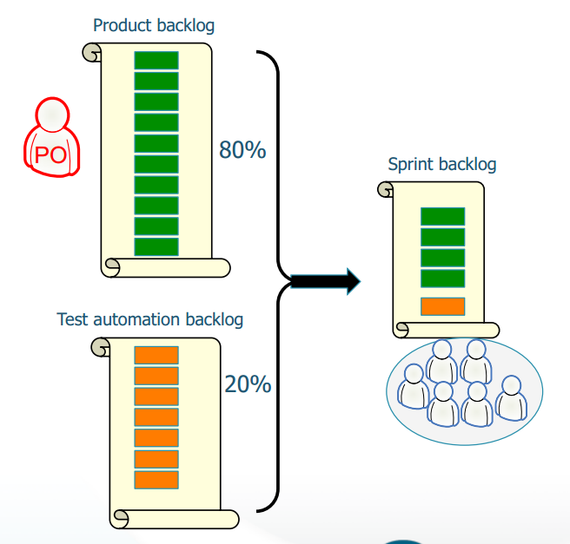
Distribuir en cada sprint
http://www.jfokus.se/jfokus11/preso/jf11_ScrumAndXPBeyondTheTrenches.pdf
Notes:
http://www.jfokus.se/jfokus11/preso/jf11_ScrumAndXPBeyondTheTrenches.pdf

Slide 45
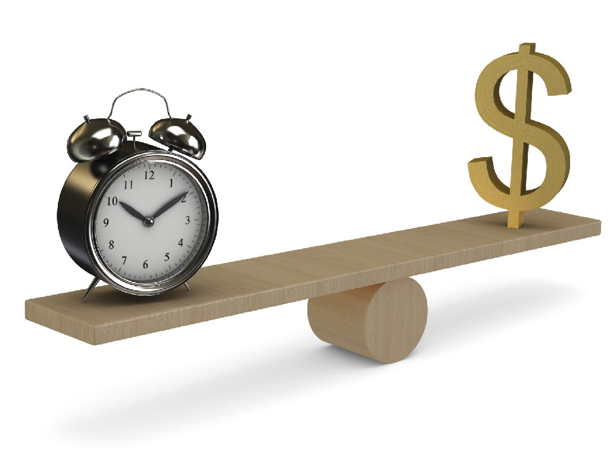
Incluir la calidad en la gestión del portfolio

Slide 46
Medida de éxito tradicional
Scope
Problemas
Se debe medir Outcomes no Outputs. (Business Value).
No considera la Calidad.
Cost
Schedule
Notes:
Value es importante
http://jimhighsmith.com/beyond-scope-schedule-and-cost-the-agile-triangle/
First, let’s look at value. A number of studies have shown that 50% or more of functionality delivered is rarely or never used. Even if some of that functionality is necessary, for example the functionality for year-end accounting close, there is still a huge percentage of unused functionality in most software systems. This leads the conclusion that scope is a very poor project control mechanism
Podemos ignorar la Calidad pero los problemas de la no calidad nunca nos ignorarán.

Slide 47
“Podremos ignorar la calidad pero los problemas de la calidad nunca nos ignorarán”
Notes:
The Agile Triangle, shown in the figure and introduced in Agile Project Management2nd Edition), addresses the real goals of projects—producing value that delights customers, building in quality that speeds the development process and creates a viable platform for future enhancements, and delivering within constraints (which are scope, schedule, and cost). The Agile Triangle alters how we view success.

Slide 48
AGILE TRIANGLE
Value
Quality
Constraints (Scope, Schedule, Cost)
Notes:
TODO: Preguntas que se pueden responder
AGILE TRIANGLE
http://jimhighsmith.com/beyond-scope-schedule-and-cost-the-agile-triangle/
The Agile Triangle, gives us a different way of looking at success, addresses the real goals of projects—producing value that delights customers, building in quality that speeds the development process and creates a viable platform for future enhancements, and delivering within constraints (which are scope, schedule, and cost). The Agile Triangle alters how we view success.
QUALITY IS IMPORTANT
http://jimhighsmith.com/beyond-scope-schedule-and-cost-the-agile-triangle/
The Agile Triangle elevates the critical role of quality, a dimension we have given lip service to for far too long. If we are serious about quality then it deserves a primary place in any measurement program. Quality comes in two flavors—today and tomorrow. “Today” quality addresses the current iteration or release of a product. It measures the reliability of the product—“Does it operate correctly?” If a product operates reliably, it delivers value to the customer in the form of implemented features. Products that are un-reliable, ones that give incorrect answers or periodically fail completely will fail to deliver current value.
The second dimension is future quality—“Can the product continue to deliver value in the future?” The ability to deliver in the future tests an application’s ability to respond to business changes, both anticipated and unanticipated. While we can often use flexible designs for anticipated changes, allowing for tax table changes for example, the strategy to deal with unanticipated changes is different. Responding to the unanticipated future requires adaptability, and the key to adaptability is keeping technical debt low.
VALUE AND QUAALITY ARE HARD TO MEASURE
http://blog.cutter.com/2009/08/10/beyond-scope-schedule-and-cost-measuring-agile-performance/
Admittedly it is harder to measure value and quality than it is to measure cost and schedule. However, it’s much better to have fuzzy measures of really important things that precise measures of less important things.
MEDIDAS DIFUSAS
http://jimhighsmith.com/beyond-scope-schedule-and-cost-the-agile-triangle/
Fuzzy measures of important things are better than precise measures of un-important ones
PREGUNTAS IMPORTANTES
http://theagileexecutive.com/2010/05/19/how-many-metrics-do-you-need-to-effectively-govern-the-software-process/
value, cost and technical debt address the most important high level governance considerations:
Value –> Why are we doing the project?
Cost –> Can we afford the project?
Technical debt –> Is the execution risk acceptable?

Slide 49
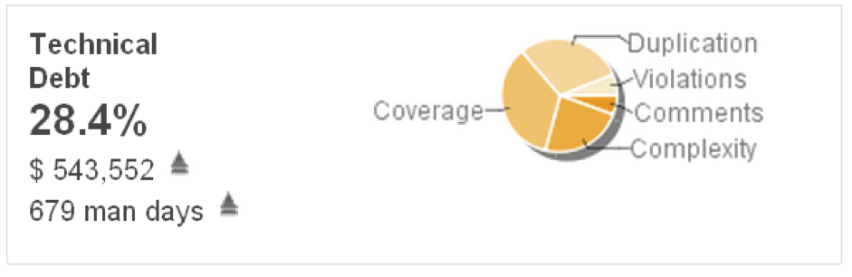
MÉTRICA
Medida cuantificable y monetaria
de la "NO CALIDAD".
Ratio de la Deuda
Distribución
Costo de reparar la deuda
Notes:
REF: SPaMCAST – Interview Israel Gat
Básicamente es una medida cuantitativa de que tan bien o pobre está nuestro software y lo expresa como deuda financier en términos de dinero que se tiene que pagar.
http://www.sqale.org/blog/why-managers-like-the-technical-debt-concept
Technical debt is an objective measure of quality. In fact it measures “non-quality” and tells you how far (in terms of days, $…) you are from complying with your “right code” definition. This is a very simple concept. It is easy to understand and facilitates communication.
http://blog.techdebt.org/interviews/230/interview-with-israel-gat-on-technical-debt-cutter-consortium
“The sum of remediation costs for all non-compliances.” Precise; concise; actionable.
http://docs.codehaus.org/display/SONAR/Technical+Debt+Plugin
The debt ratio
The debt ratio gives a percentage of the current technical debt of the project versus the total possible debt for the project. It enables to better compare projects. Indeed having $ 10,000 debt on a "small" project does not mean the same as the same debt on a big project.
The cost to reimburse
This gives in $$ what it would cost to clean all defects on every axis (no more violations, no more duplications...).
The work to reimburse
This is the cost to reimburse expressed in man days.
The breakdown
This gives through a pie chart a view of the debt distribution across the 6 quality axes

Slide 50
Cuantificar la deuda
El riesgo de ejecución es aceptable?
El producto puede continuar dando valor en el futuro?
Definir límites para tomar decisiones informadas.
Notes:
Más útil para iniciar discusión y no tanto como un número específico para una hoja de cálculo
http://www.infoq.com/news/2010/03/monetizing-technical-debt
According to Israel, there are multiple benefits of monetizing the technical debt.
It tells the teams when to stop developing and start refactoring - When the technical debt reaches a certain level (say 25 cents per line of code), new functionality is put on hold. The team gets into refactoring mode and no functionality is added until the debt is brought down.
Customers of the software get an idea of how risky the software is – Israel suggested that this is inline with the Agile Manifesto “Customer collaboration over contract negotiations”.
Makes investment decisions easy for Venture Capitalist – VC's can determine the rationale for making an investment in a software product.
Determines the affordability of the software – Helps answer the questions about affordability of the development and maintenance of the software as it evolves through the software lifecycle.
Helps in making the refactor versus rewrite decision – Associating technical debt with other important factors helps in making a decision to start afresh.
Helps in defining credit limits – Once monetary credit limits have been defined, they help all stakeholders including the CxO's to take informed decisions.
NOW WE CAN NOW DISCUSS TECHNICAL DEBT IN GENUINE FINANCIAL TERMS
http://blog.cutter.com/2010/05/19/three-governance-metrics/
enable clients to quantify technical debt and express it in dollar terms. Now we can now discuss technical debt in genuine financial terms. For example: “Madam/Sir, your technical debt amounts to $2 per line of code.”
The ability to monetize technical debt enables convergence on two all-important “dimensions” of the software process:
Value, cost and technical debt come together to provide effective governance of the software process through the Agile Triangle framework developed by Cutter Fellow Jim Highsmith. Technical and non-technical people have a meaningful common denominator ($) for dialoging.

Slide 51
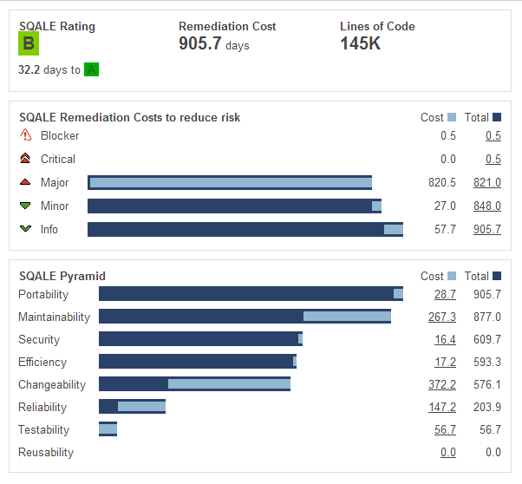
SQALE

Slide 52
Preguntas
Angel Núñez Salazar
angel.nunez@kleer.la
snahider.blogspot.com
@snahider

Slide 53

software debt assesment
Te ayudamos a entender y mejorar tu software desde una perspectiva de riesgo
Notes:
The focus of a technical debt assessment is to under-stand the organization’s code lines in detail from a risk perspective. In addition to software code assets, there is also some focus on release management and source control management. The three main areas for improve-ment that we typically find in technical debt analyses and interviews are the following:

Slide 54


¿ Cómo nos sentimos acerca de la calidad de nuestro código ?
1
5
Notes:
Most likely, however, you will see a bunch of 2s or worse, and very few 4s and 5s. The term for this is Technical Debt,
Congratulations, you have just revealed a serious problem! You have even quantified it.
Don’t worry, you aren’t alone, this is a very common problem. <rant>However, it’s also a very stupid, unnecessary problem so I’m baffled by why it is so common.</rant>

